Slide 1

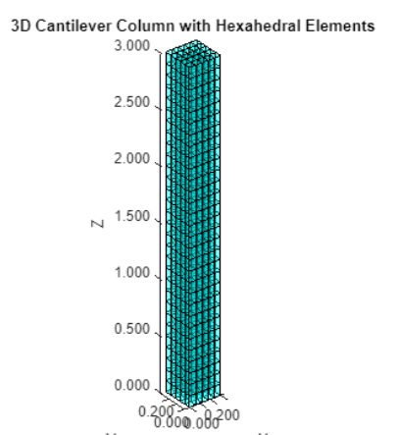
FINITE ELEMENT ANALYSIS
The study of developing a Finite Element Method (FEM) implementation for structural analysis.
GROUP 4
THANAWAT THIRABANCHASAK(124914)
AASHISH BHATTA(125353)
MUHAMMAD ABDUL AHAD(125499)
ZAW MYO MYAT(125102)
GUDIYA BHANDARI(124979)

Slide 2
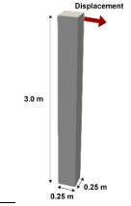
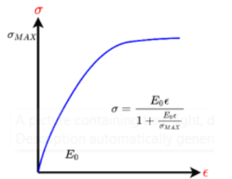
THE PROBLEM
Material Properties
f’c = 30 Mpa
E0=2.574x10^10 Pa
ν = 0.2
σmax = 30x10^6 Pa
σ = E0xϵ/(1+E0xϵ/σmax)
Concrete Density =2400 Kg/m3
1

Slide 3
Flow Chart of the Project
Meshing the column into Hexahedron elements with specified element size
Extract nodal Coordinate and Member connectivity in MATLAB
Defining Sigma_max, Density, E0, shape function, and D matrix
Non-linear Analysis - Pure Incremental method
Assigning Support condition at base nodes
Load at top equivalent to 4% of height.
Formulation of the Global stiffness matrix and Force vector using Iso parametric Formulation
No
Solving equilibrium equation to obtain the nodal displacements, stresses and strain in each incremental step
Checking the Failure criteria using Coulomb-Mohr Failure criteria in each incremental step
Fail
Yes
Stop
2

Slide 4
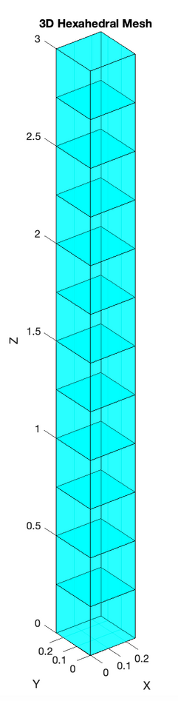
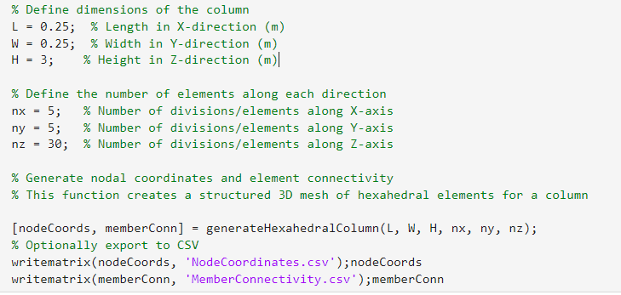
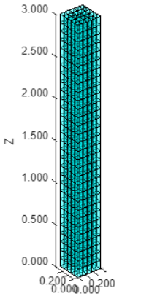

MESHING
Meshing
MATLAB CODE BASE MESHING TO EASILY VARY THE NUMBER OF ELEMENTS ALONG X,Y,Z DIRECTION
3

Slide 5
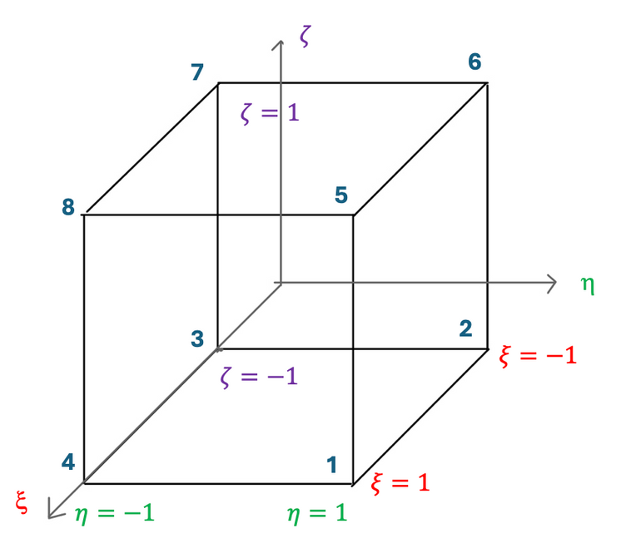
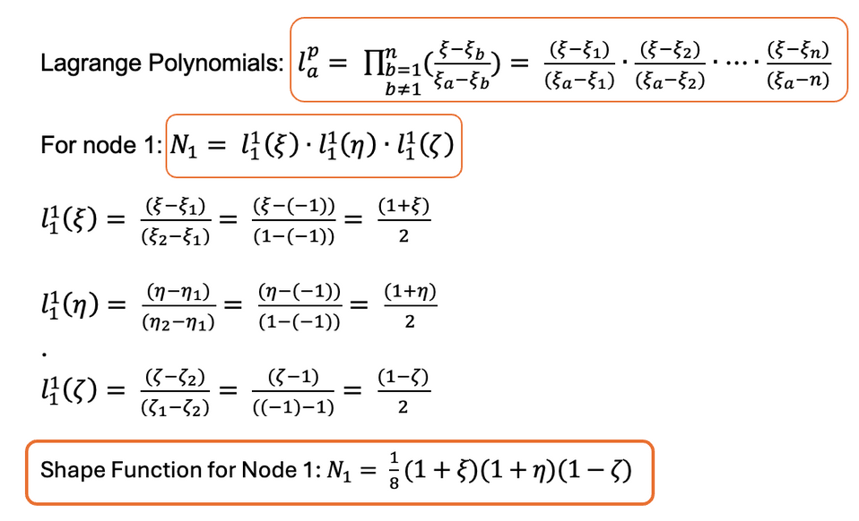
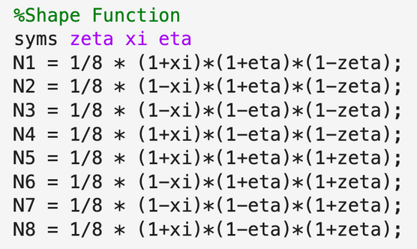
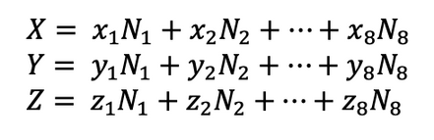
Shape Function
Meshing
Concept (Global Parametric System to Parent Coordinate System)
Parent Coordinate System
Global Parametric System
(x,y,z coordinate)
Local Stiffness Mat.
Local Mass Mat.
Global Stiffness Mat.
Global Mass Mat.
3

Slide 6
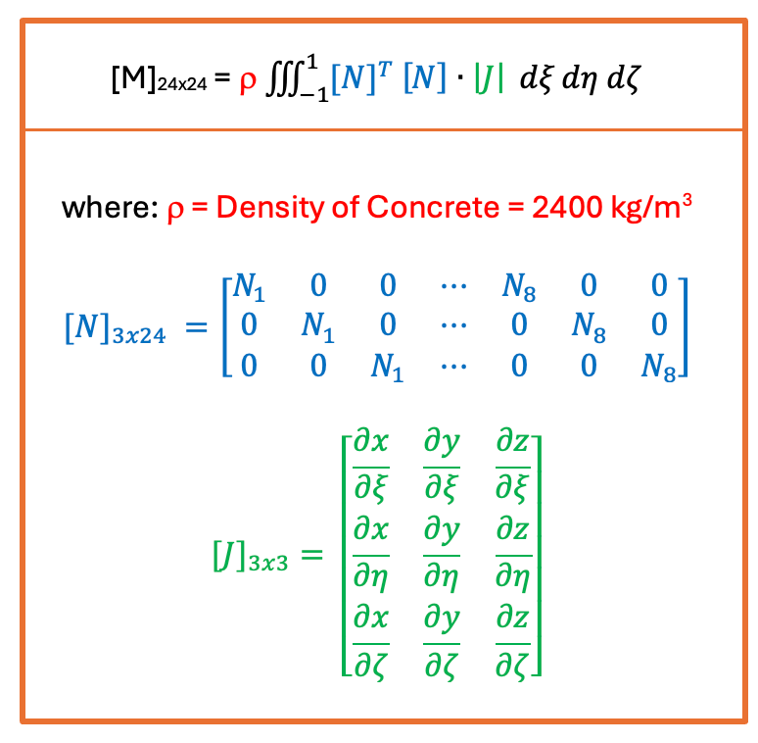
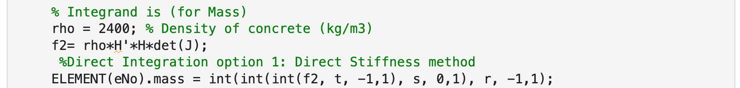
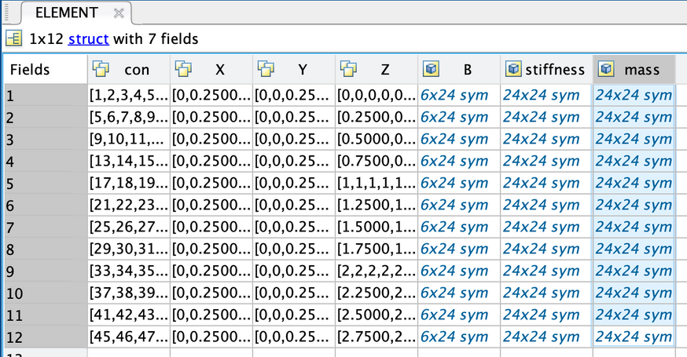
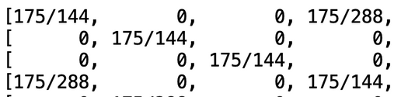
Mass Matrix
Concept
Script
Result
for 1 element
24x24
1/16
4

Slide 7
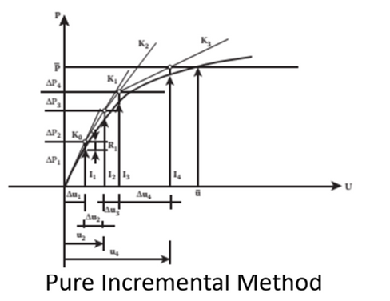
Non Linear - Pure Incremental Method (Flow chart)
Total Force: 100,000 N
(example)
Assume: Total Incremental: 5
Delta F1 = 100,000/5 =20,000 N
D MATRIX(E)
[U] = [K]-1[F]
GETHDSTRESSSTIFFNESS.M
ELEMENT
STRESS
ELEMENT
STRAIN
ELEMENT
DISPLACEMENT
Max. Shear Stress > Max. Shear Failure
FALSE
TRUE
MATERIAL FAIL
1/16
5

Slide 8
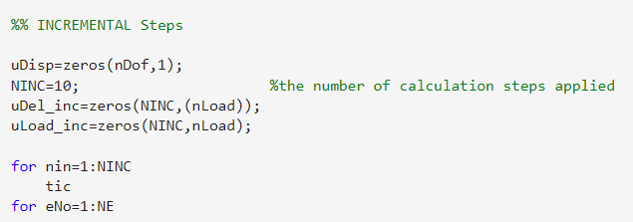
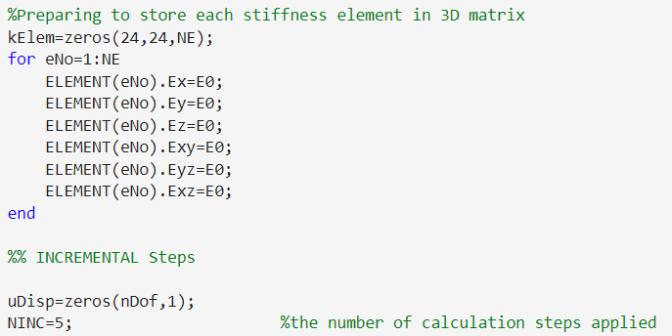
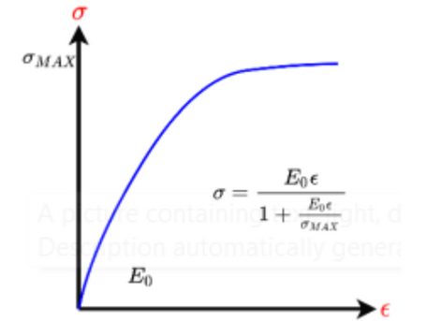
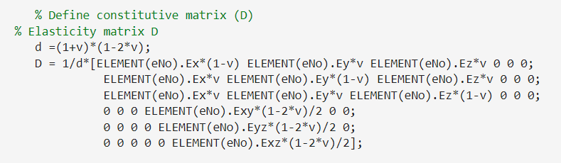
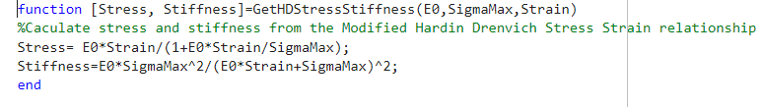
Pure Incremental Method MATLAB Solver
6

Slide 9
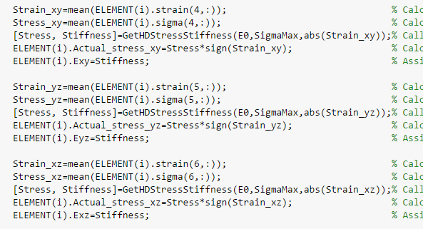
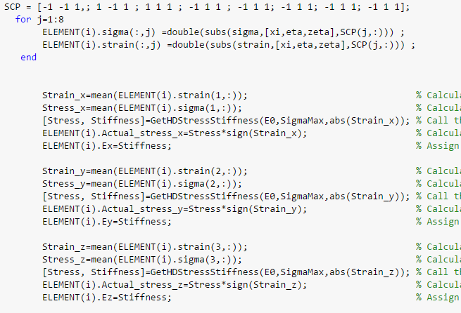
Pure Incremental Method MATLAB Solver
6

Slide 10
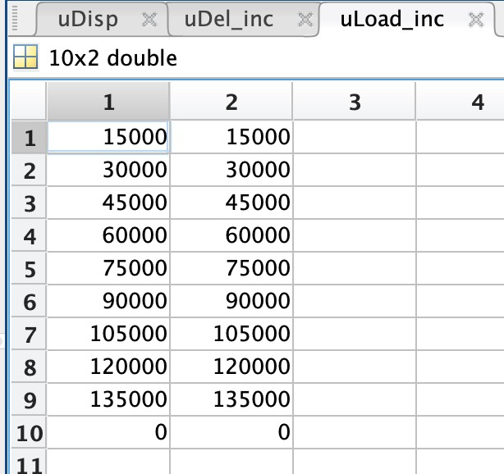
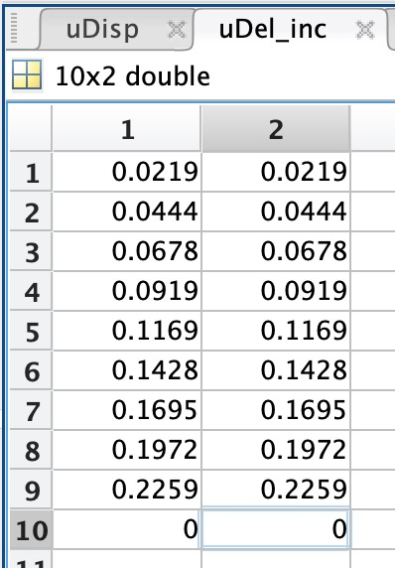
Checking Load increment to get desired displacement
The total load applied is 27*10^4 N to get the desired displacement at force step 9
the corresponding load for each node is 13.5*10^4 N. (2 nodes)
the displacement at 4% is around 0.22 m.
6

Slide 11
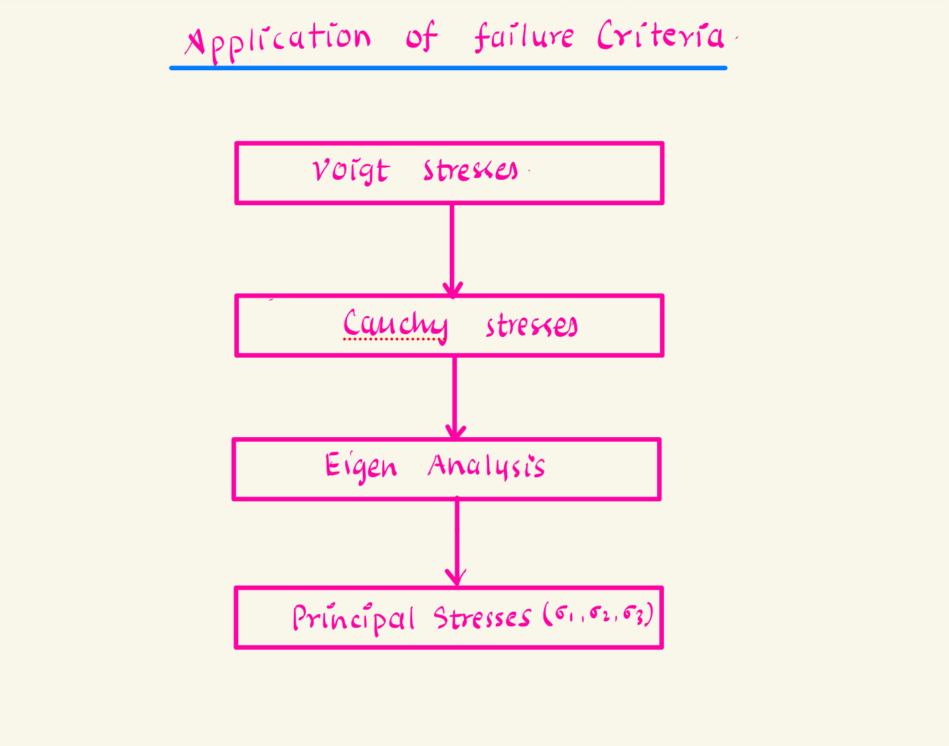

Slide 12
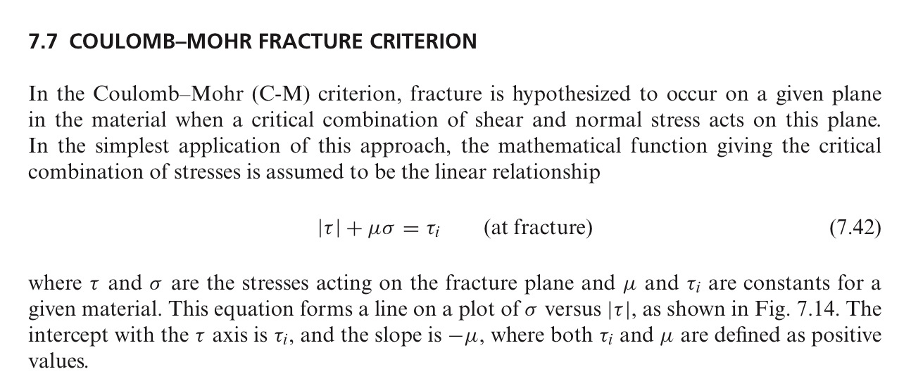
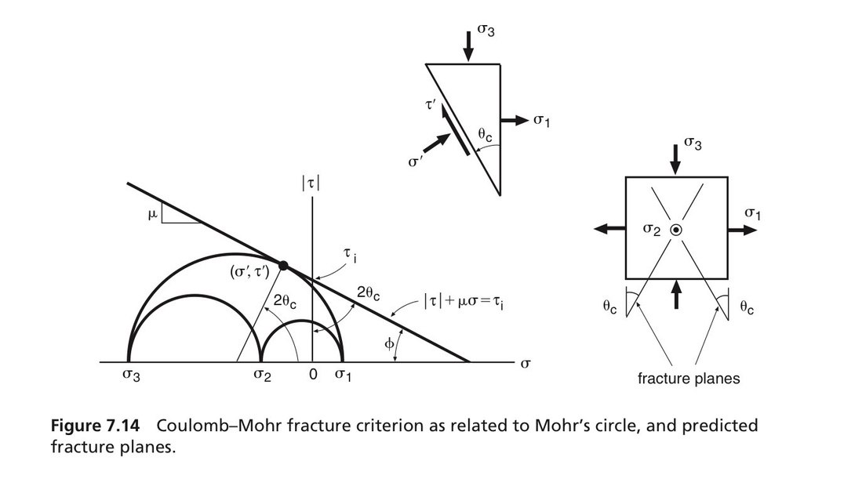
MOHR- COLOUMB FAILURE CRITERIA
Here for the analysis of at what point beam has failed, we using a failure criteria which is Mohr-Coulomb
7

Slide 13
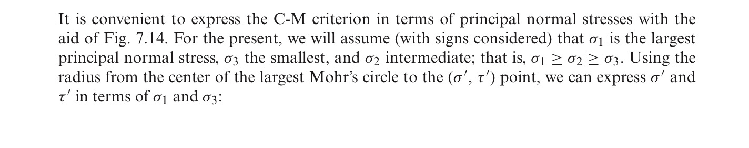
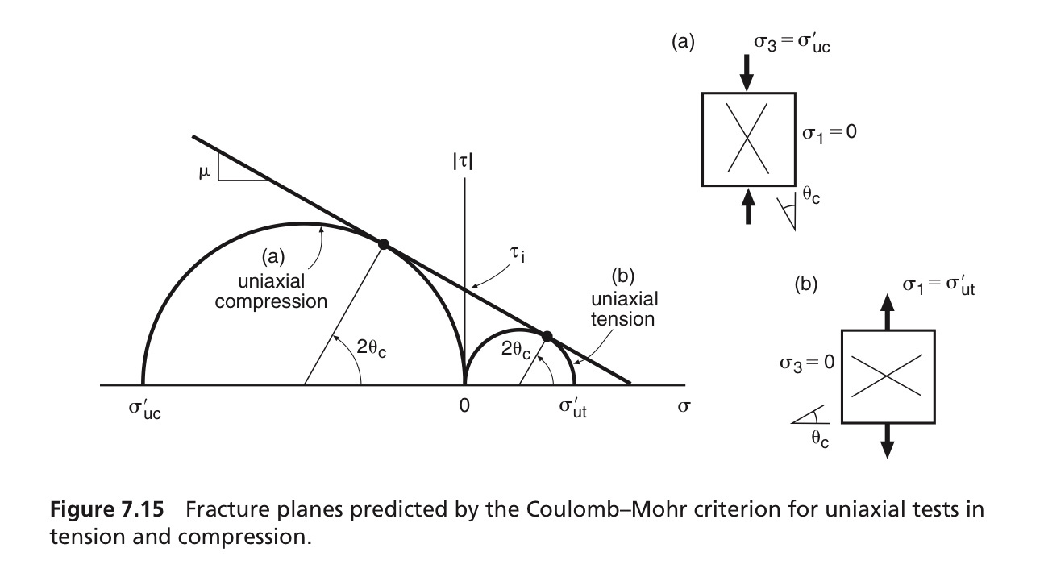
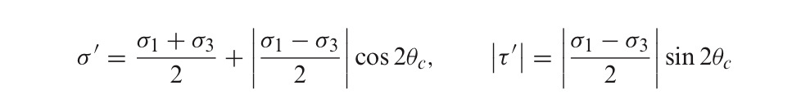
COULOMB-MOHR FACTURE CRITERION
9

Slide 14
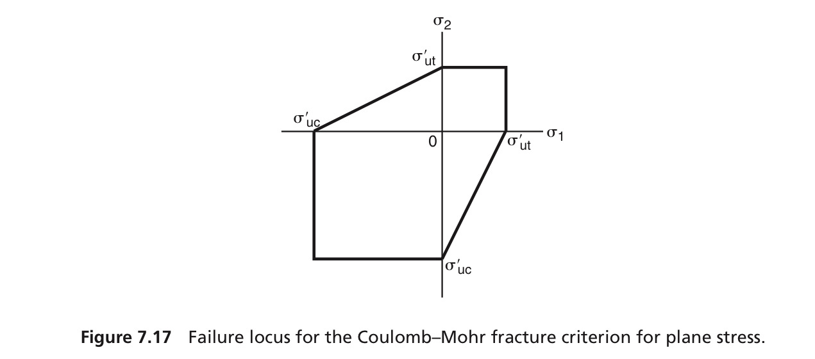
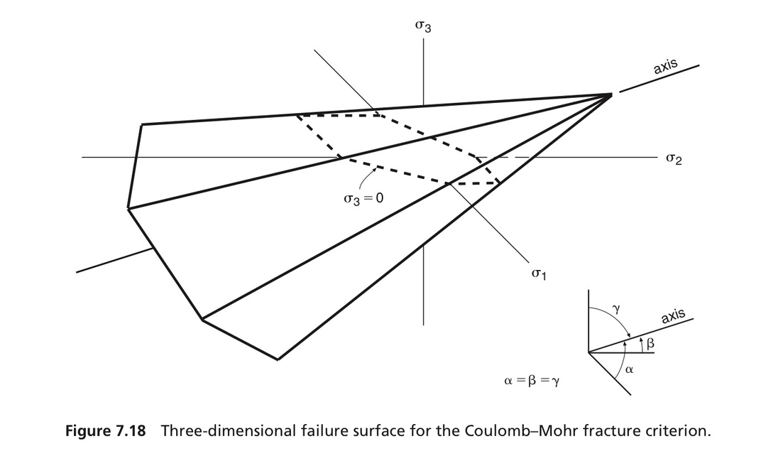
GRAPHICAL REPRESENTATION OF THE COULOMB-MOHR CRITERION
9

Slide 15
WHY WE CHOOSE MOHR-COULOMB FAILURE CRITERIA FOR THIS CASE?
Failure Envelope for Brittle Materials:
Concrete is a quasi-brittle material, making it susceptible to shear and compressive failure. Mohr-Coulomb effectively captures both shear and compressive failure modes, aligning well with concrete's response to large displacements.
Capturing Shear and Compressive Cracking:
Under 4% height displacement, the beam is likely to experience significant shear stresses. Mohr-Coulomb criteria can predict the initiation of shear cracks and their propagation based on cohesion and internal friction angle parameters.
9

Slide 16
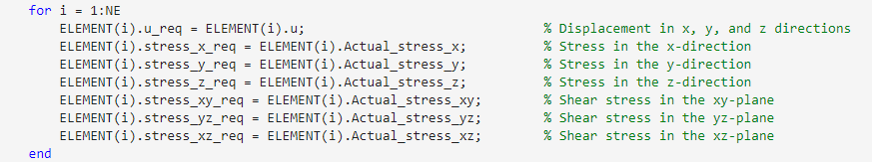
CODING IN MATLAB FOR APPLYING THE COULOMB-MOHR FAILURE CRITERIA
IMPLEMENTATION OF FAILURE CRITERIA IN MAIN SCRIPT
In the main code of non linear analysis after implementation of each load step we will get the the calculation of stress values for each stress element
Before calculation of residual force and implementation of the next step force
we will insert the failure criteria checking code to evalute the remaing strength of concrete
if the maximum stress limited is reached the loop will end
9

Slide 17
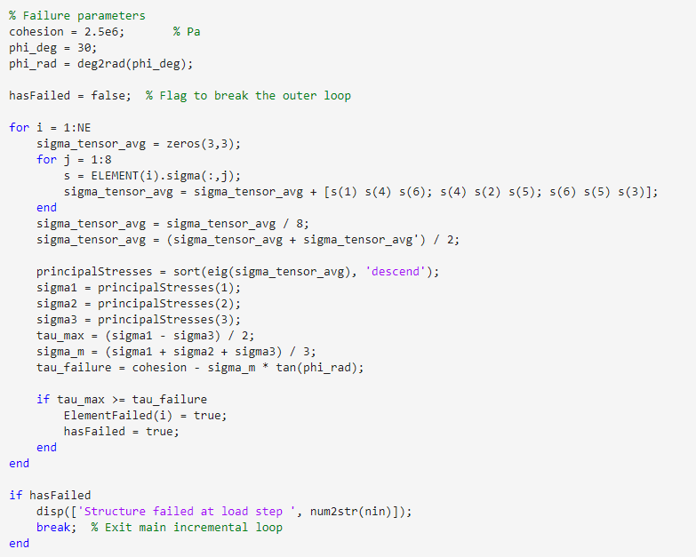
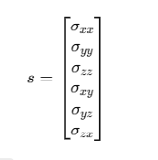
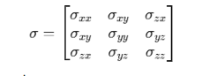
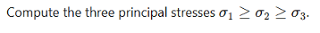
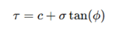
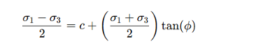
CODING IN MATLAB FOR APPLYING THE COULOMB-MOHR FAILURE CRITERIA
IMPLEMENTATION OF FAILURE CRITERIA IN MAIN SCRIPT
9

Slide 18
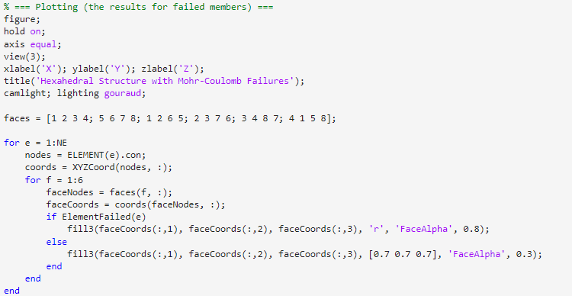
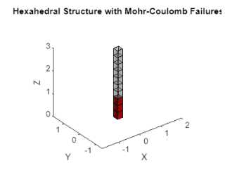
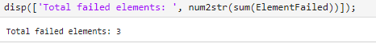
CODING IN MATLAB FOR APPLYING THE COULOMB-MOHR FAILURE CRITERIA
once the failure criteria is reached we can plot the element and visulize the result
9

Slide 19
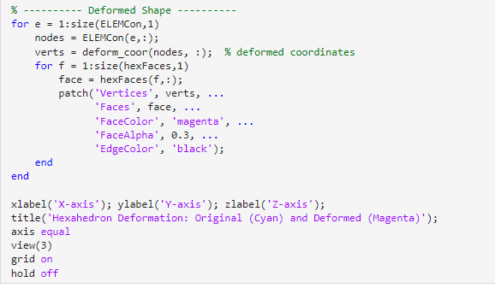
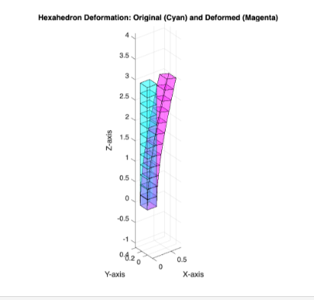
POST PROCESSING
9

Slide 20
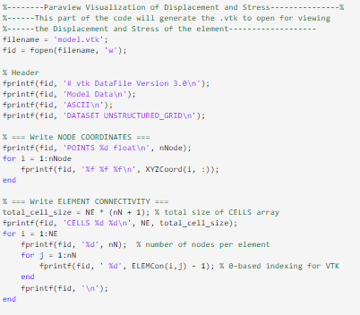
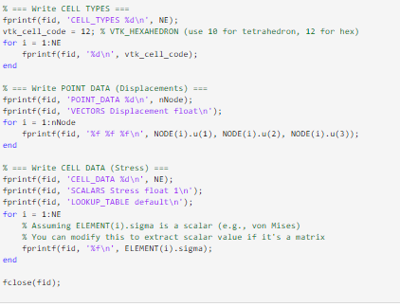
POST PROCESSING
9

Slide 21
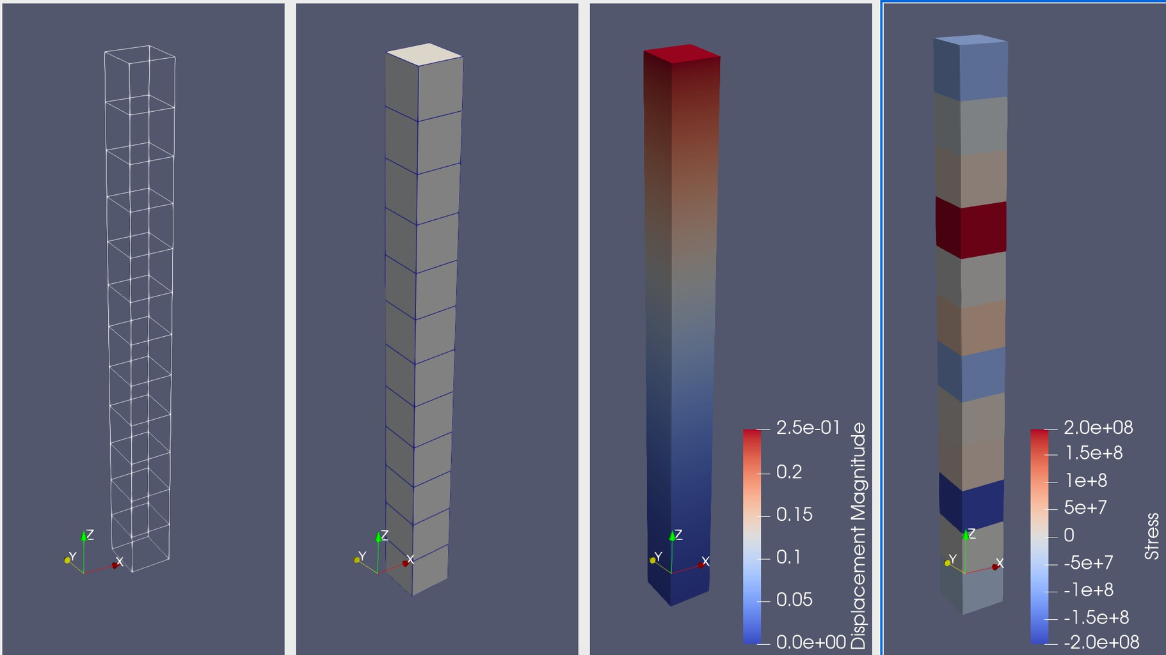
POST-PROCESSING
6

Slide 22
LIMITATIONS
Using a pure Incremental method without correction prevents the structure from reaching true equilibrium at each step, reducing accuracy in nonlinear simulations
Averaging stress and strain across each hexahedral element can underestimate stress concentrations, particularly near boundaries, corners, and load application points.
The use of force control limits the ability to capture the material's softening behavior.
9

Slide 23
FUTURE IMPLIMENTATIONS
Displacement-controlled static analysis can be applied to simulate structural behavior beyond peak load, enabling capture of failure modes such as cracking, yielding, and post-peak softening.
we can Incorporate Modified Newton-Raphson ( partially updated stiffness) for future improve the results.
TO support nonlinear time history analysis using methods like Newmark-beta allowing simulation of seismic, impact.
we can Incorporate nonlinear constitutive models such as:
Concrete plasticity or damage-plasticity
Concrete cracking models with tension softening and shear transfer.
9

Slide 24
REFERENCES
Introduction to Nonlinear Finite Element Analysis - Nam-Ho Kim
The Finite Element Method, Fifth Edition, Volume 1: The Basis - Zienkiewicz
Finite Element Procedure - Klaus Jurgen Bathe
Programming the Finite Element Method - I.M. Smith, D.V. Griffiths and L. Margetts
A First Course in the Finite Element Method - Daryl L. Logan
9

Slide 25
QUESTIONS ?
THANK YOU
9

